Slide 1

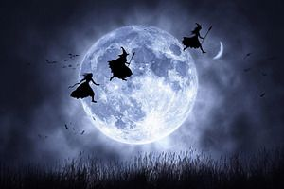





Slide 2
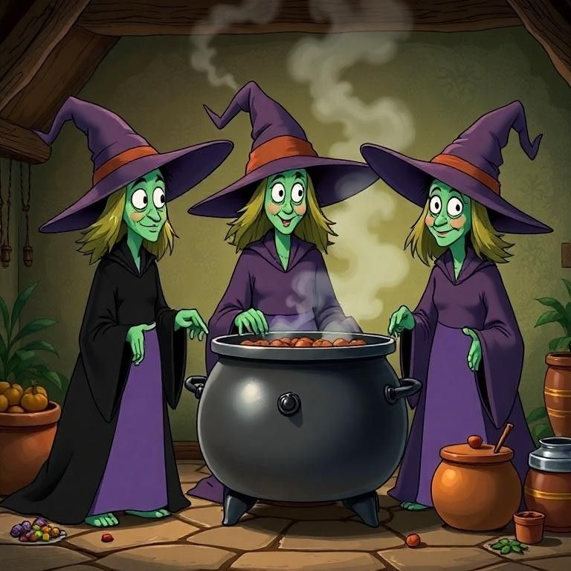
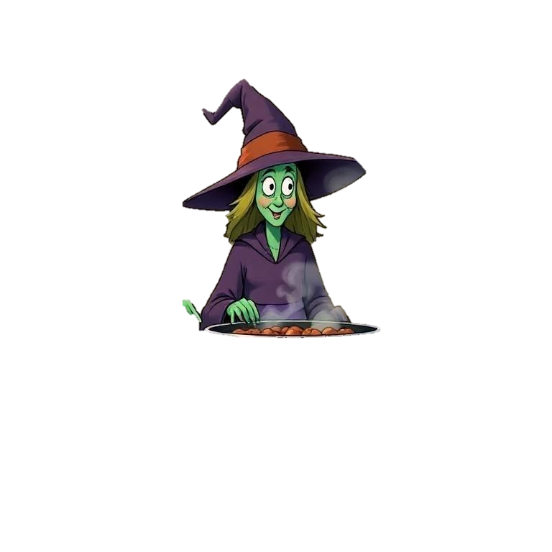
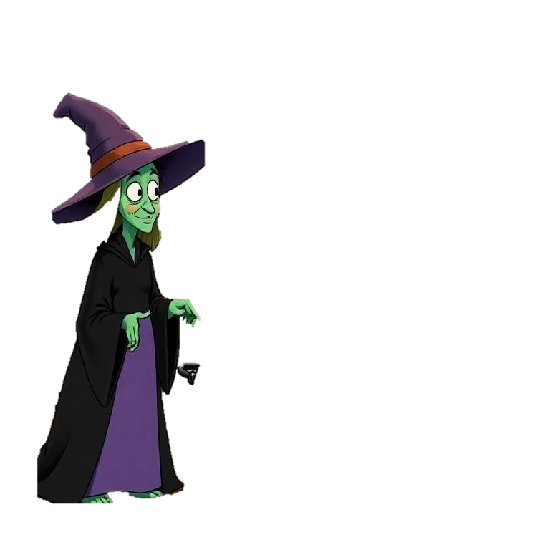
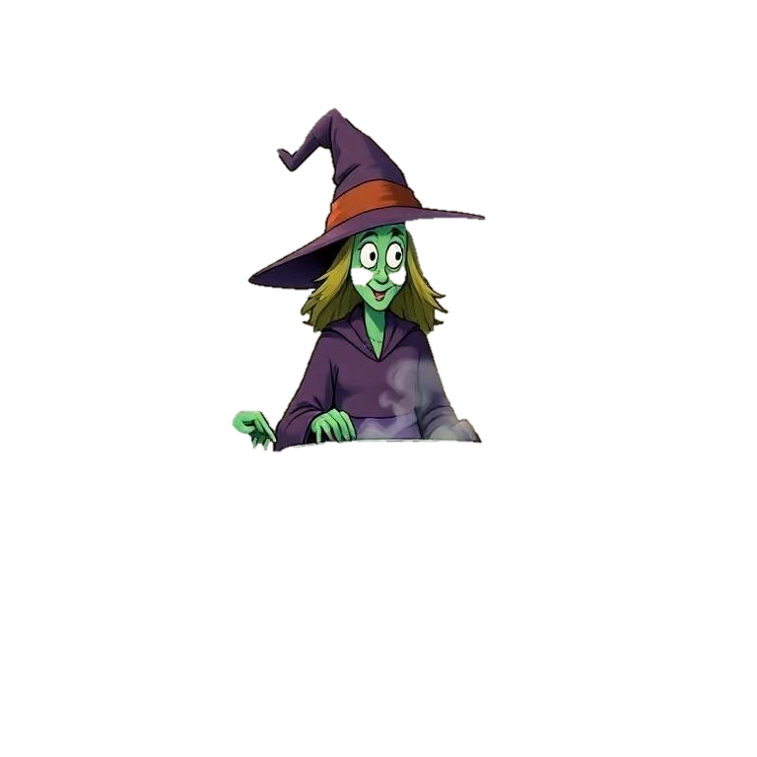
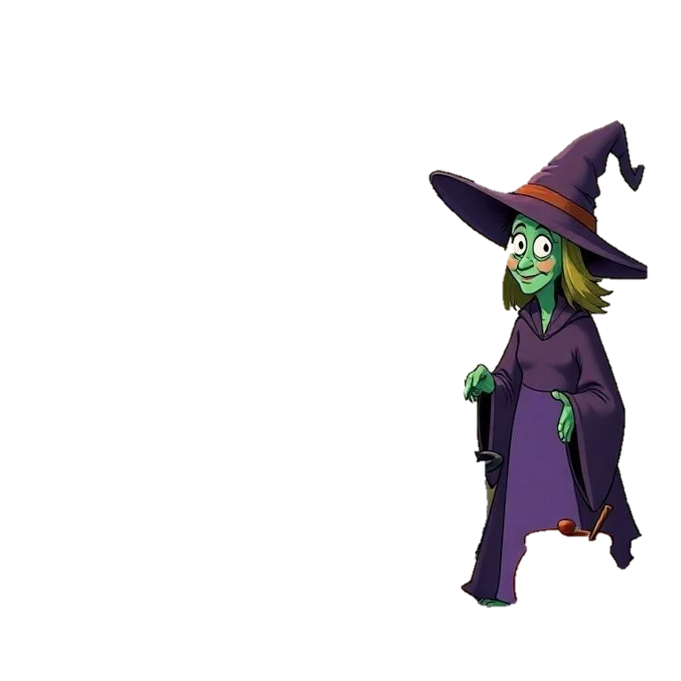

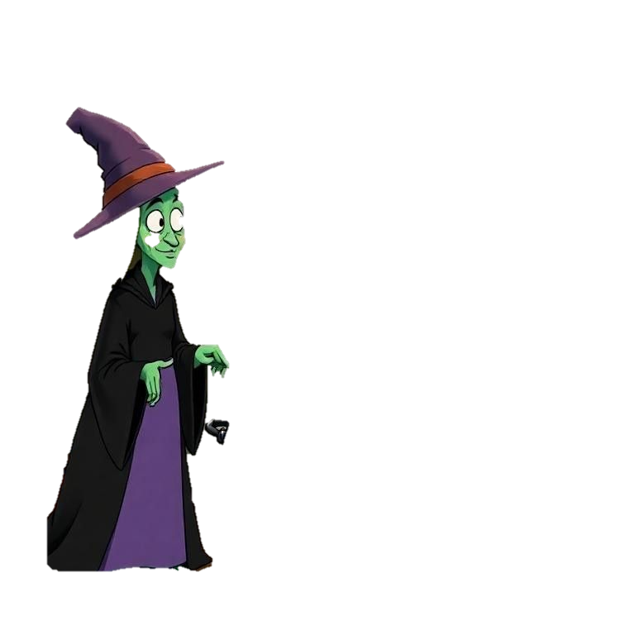
Once upon a time, in the cheerful village of Willowbrook, there lived three little witches Willa, Mina, and Dot.They weren’t the kind of witches who scared people. Oh no! They were helpful witches who used their magic to make gardens bloom and cakes rise perfectly in the oven;

Slide 3







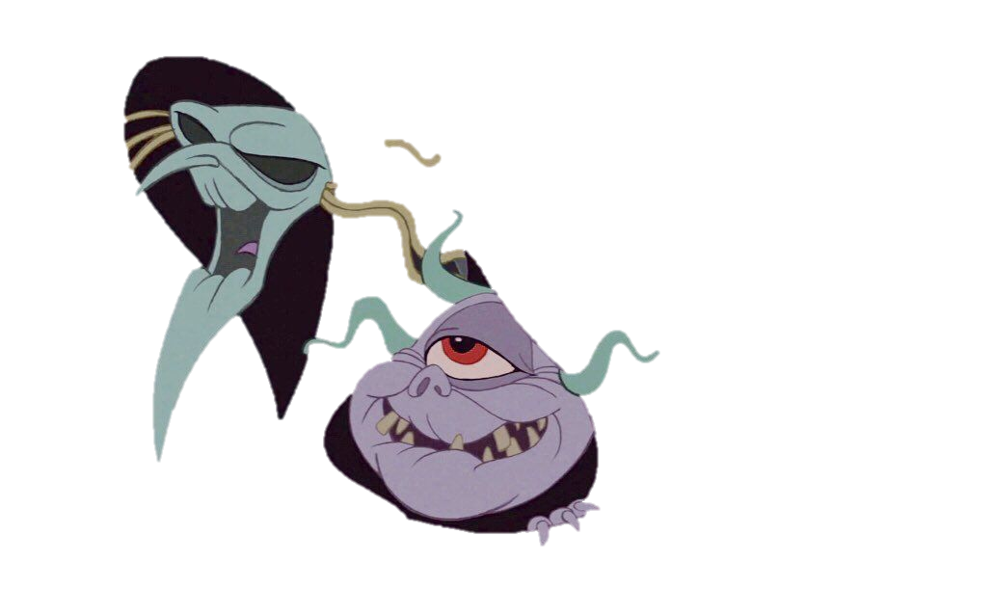
One evening, as the stars began to twinkle, the three witches noticed something strange 🌙 the moon was missing!“Oh no!” gasped Willa. “How will the owls see where to fly?”

Slide 4
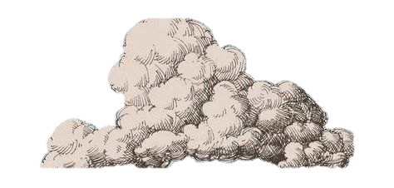
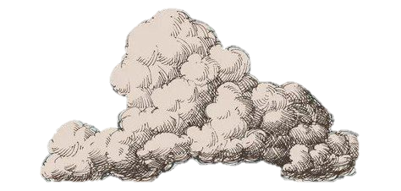
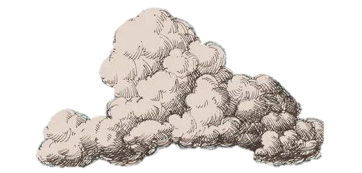

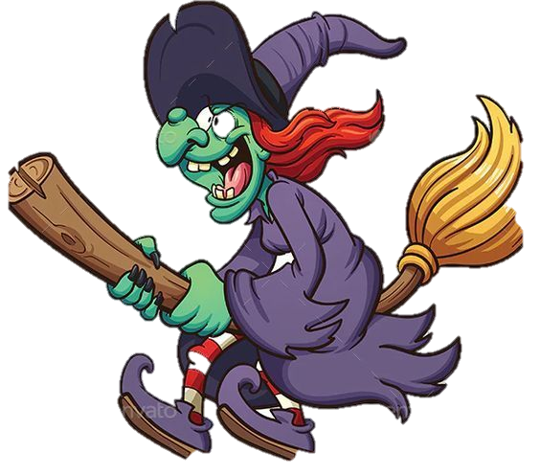
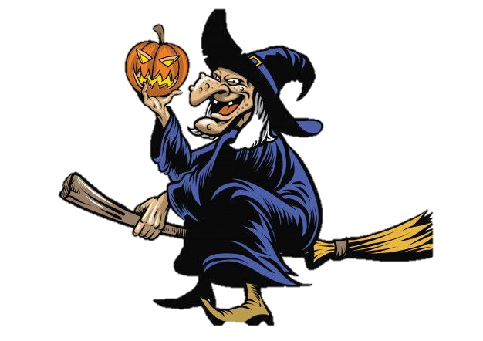
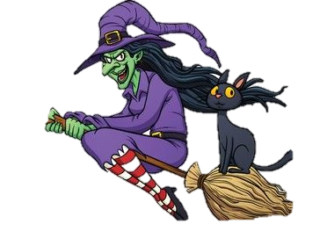
We must find the moonlight!” said Mina, grabbing her glowing broom.Dot, the smallest witch, waved her wand and whispered,“Sparkle, sparkle, show us the way!”The three zoomed off into the dark sky. They searched behind clouds, inside mountains, and even in the pockets of sleeping giants but no moon!

Slide 5
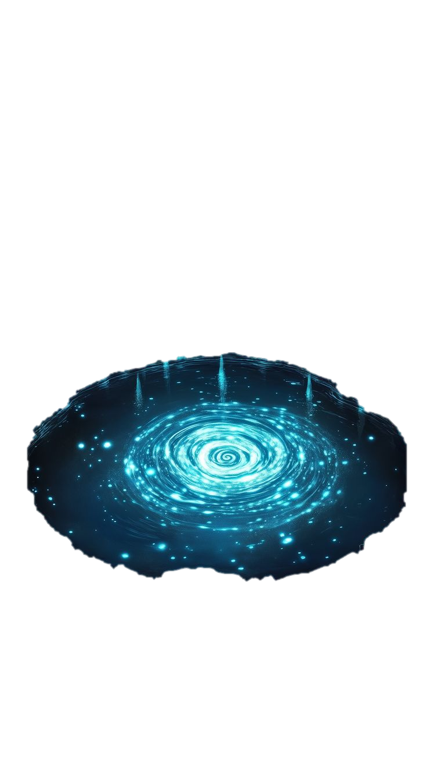
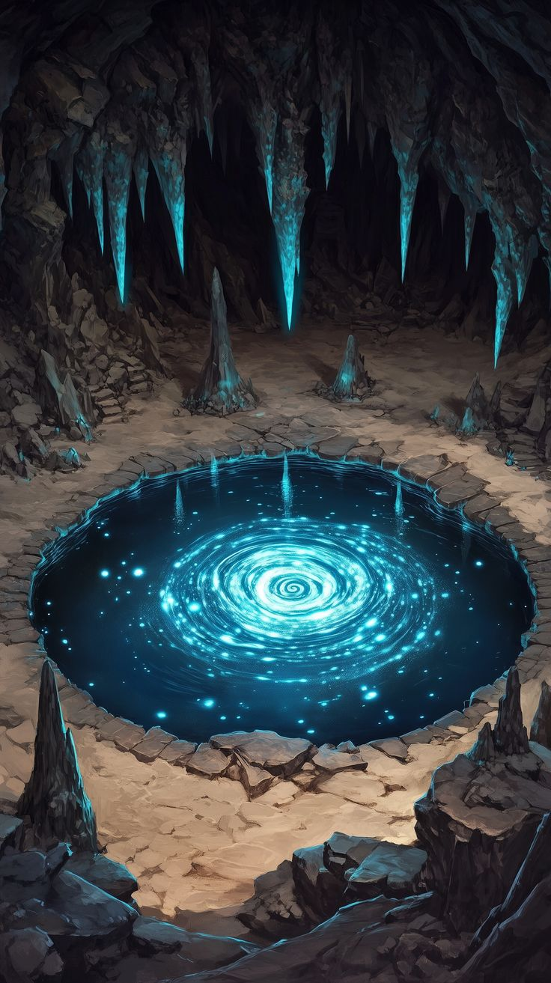
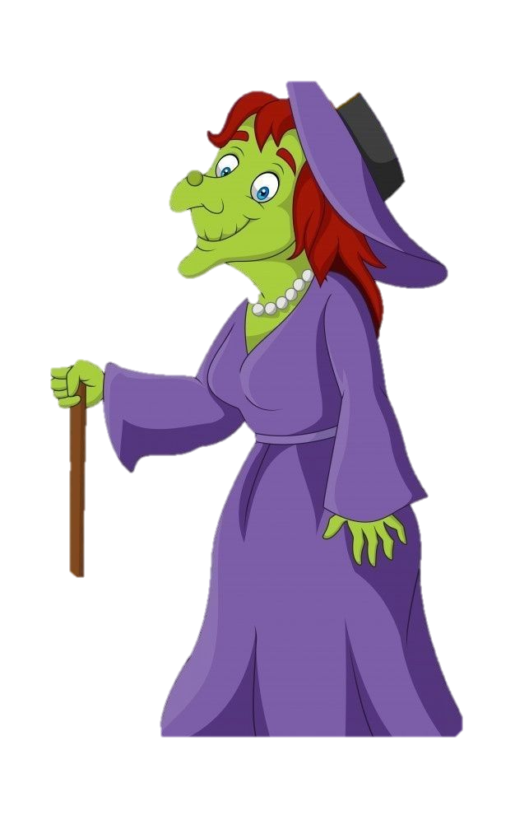
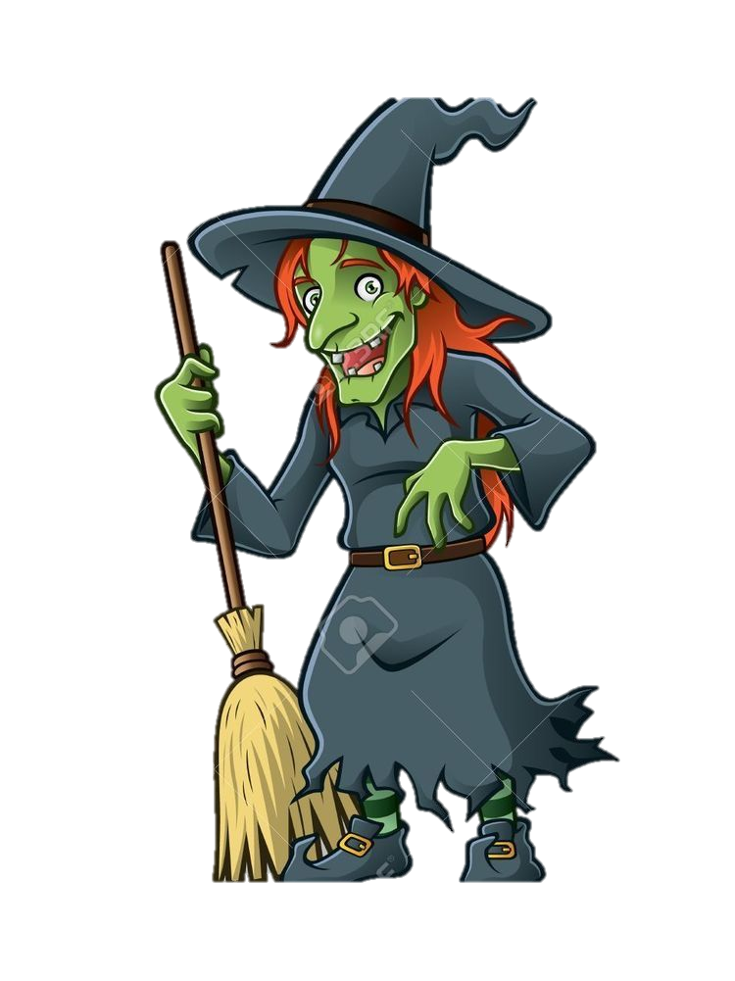

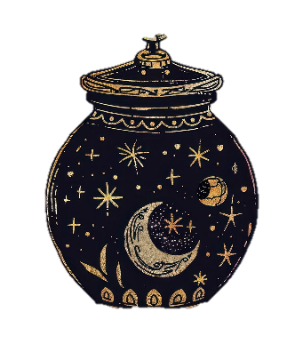

Finally, they heard soft crying from a crystal lake.There sat a tiny moonbeam, trapped in a jar!A lonely frog had found it and kept it as his nightlight.“Oh, little frog,” said Dot gently, “the sky needs this moonbeam.”The frog blinked sadly but nodded. “Can I still have some light for my pond?”“Of course!” said Willa, tapping her wand. A small silver star appeared and floated beside him.

Slide 6
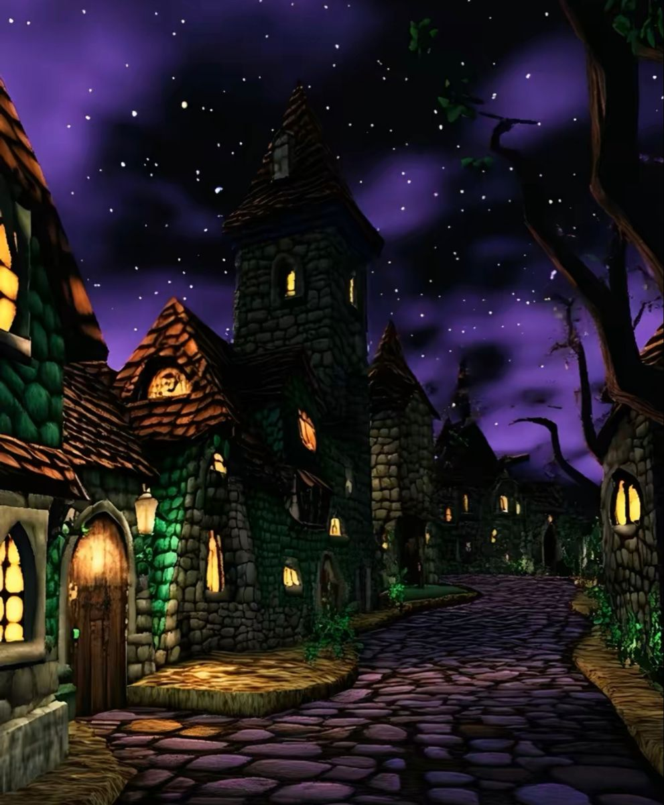

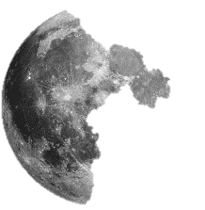
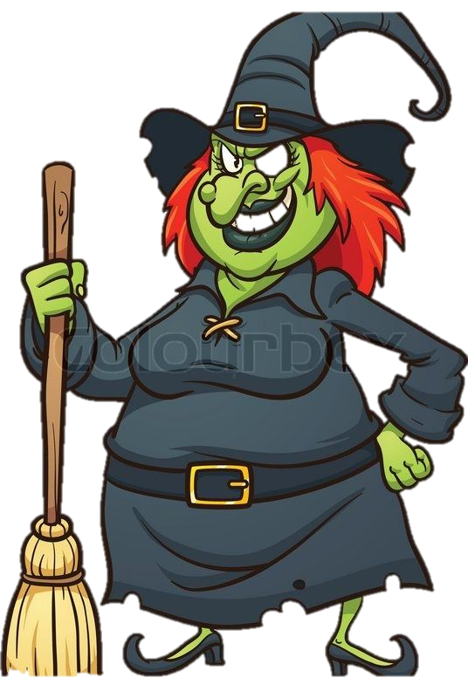
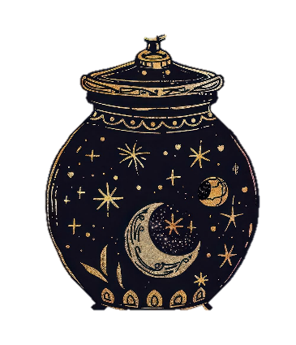
With a swirl of stardust, the witches set the moonbeam free, and it rose high into the sky. The moon shone brighter than ever, smiling down at them.The witches cheered, the frogs croaked happily, and the whole village bathed in silver light once again.From that night on, whenever the moon glowed extra bright, everyone in Willowbrook knew 🌙 the three kind witches had done their magic again.

